Slide 1

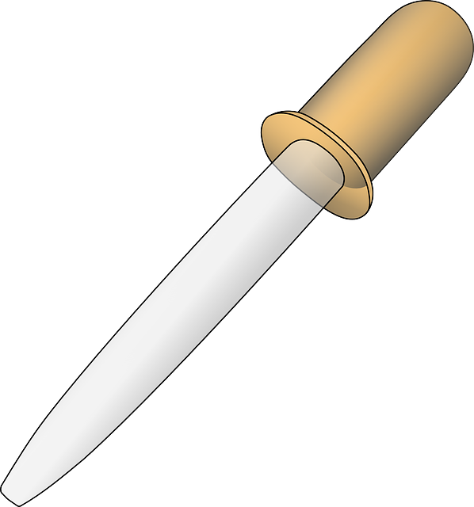
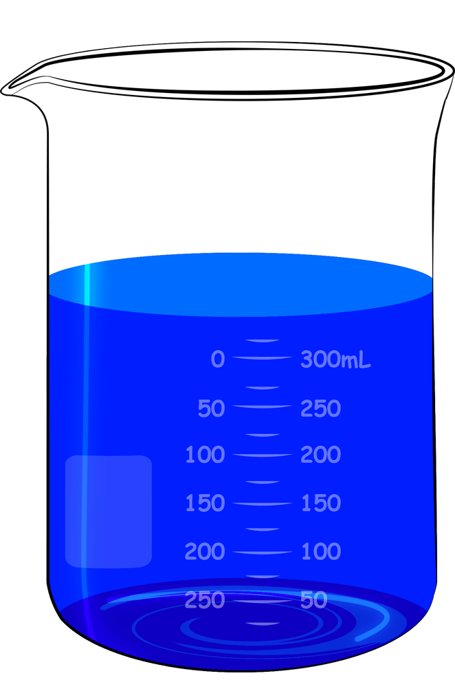
White tile
Glass slide
Distilled water
Tissue
Cheek cells
Coverslip
Methylene blue
Methylene blue

